Slide 1

Developing a structured narrative with an improvement message
Jose Lourtie
NELA Project Manager
Royal College of Anaesthetists
Notes:
I’m here today to talk to you about the National Emergency Laparotomy Audit. You may have seen mentioned of this work around the College.
But before I get onto the project I would like your help to resolve an issue that has plagued the audit since it started – How to pronounce its initials N E L A?

Slide 2



OR
Notes:
There are two thoughts for how to pronounce the letters N E L A – Does it rhyme with Umbrella or with Peeler?
So what do you think is it NELA or NELA?
… Now that we have resolved that important issue we can go on…

Slide 3
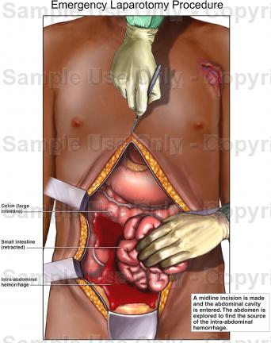
NATIONAL EMERGENCY LAPAROTOMY AUDIT
WHAT IS A LAPAROTOMY:
Notes:
So what exactly is a Laparotomy:
It is an operation for people with severe abdominal pain to find the cause of the problem.
A cut / incision is made to open the abdomen (stomach area) and it is carried out for several reasons like:
Blockage / obstruction in bowel
Bowel perforation (burst)
Bleeding etc etc
You get the idea…. Not very nice

Slide 4
NATIONAL EMERGENCY LAPAROTOMY AUDIT
OVERVIEW / BACKGROUND:
Project started in December 2012
100% of eligible Hospitals registered
Over 45,000 individual patient cases entered in first two years of patient audit
6,000 users registered online and entering data
Carried out by the National Institute of Academic Anaesthesia's (NIAA) Health Services Research Centre (HSRC) on behalf of the Royal College of Anaesthetists
Being run alongside other key stakeholders (eg Royal College of Surgeons)
Notes:
So that is what a laparotomy is, now let me give you an overview of the project:
Which has been going since December 2012, with an original run of 3 years and we have recently found out it will be extended by a further 2 years.
We have all eligible hospitals in England and Wales participating
And we have had very good take up by hospitals with over 45 thousand patient cases entered and over 6,000 users registered

Slide 5
NATIONAL EMERGENCY LAPAROTOMY AUDIT
WHY IT WAS COMMISSIONED & AIMS:
30,000 Laparotomies undertaken each year
Research showed evidence that too many people die undergoing Emergency Laparotomies
Wide variation in care
15% mortality rate
Overall aim is to improve quality of care for patients undergoing Emergency Laparotomy
Notes:
It was commissioned because many laparotomies are performed each year, over 30 thousand.
Previous work by the Emergency Laparotomy Network showed evidence that too many people die undergoing Emergency Laparotomies
Overall aim of the audit
is to Improve quality of care for these patients.
We are also hoping to use the audit to facilitate quality improvement initiatives
And it allows to compare data

Slide 6


NATIONAL EMERGENCY LAPAROTOMY AUDIT
REPORT INPUT:
Clinical Reference Group
Project Team
HQIP
NHS England
Notes:
As you can see we have many stakeholders represented on the project, providing important advice. Organisations like:
- British Geriatric Society
- Patient Reps
- Commissioners
- and other Royal Colleges

Slide 7
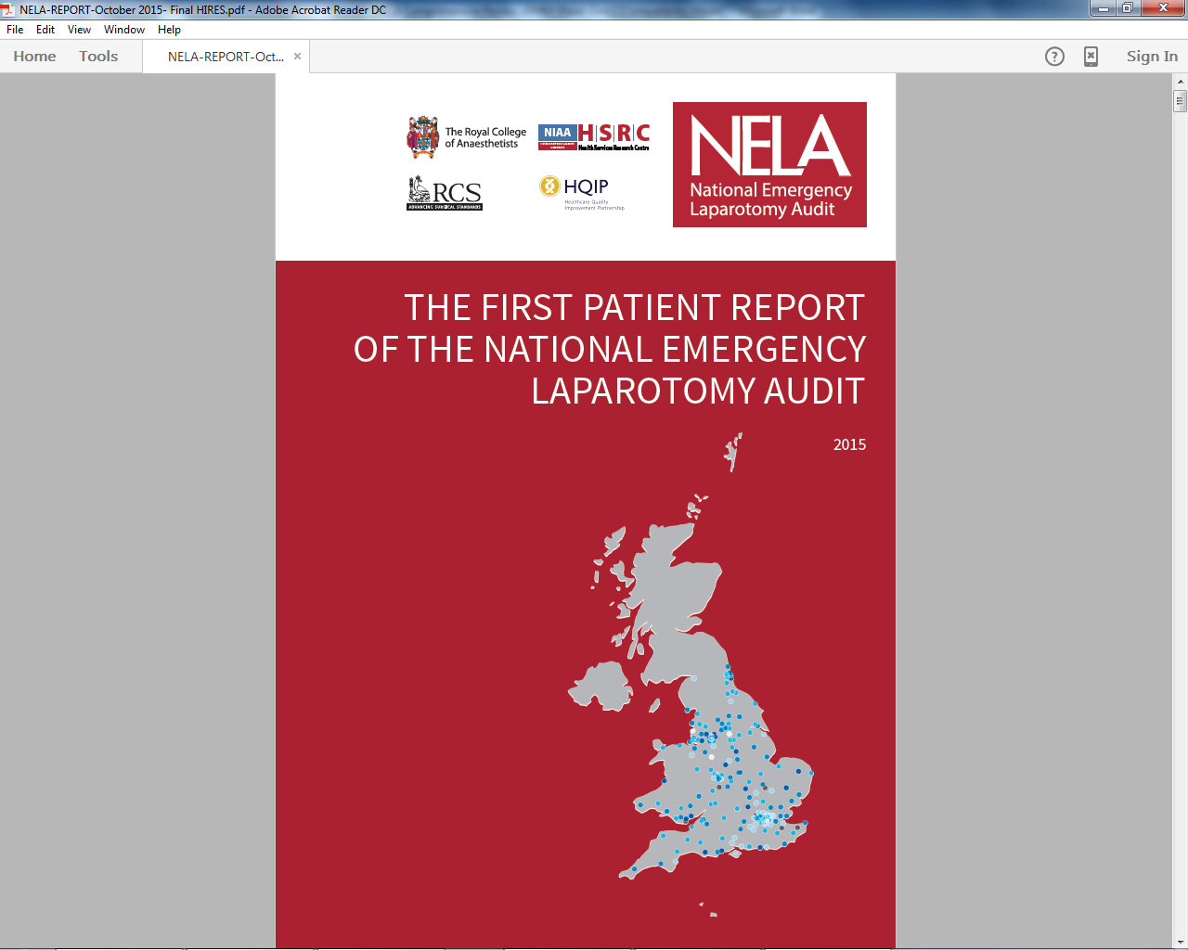
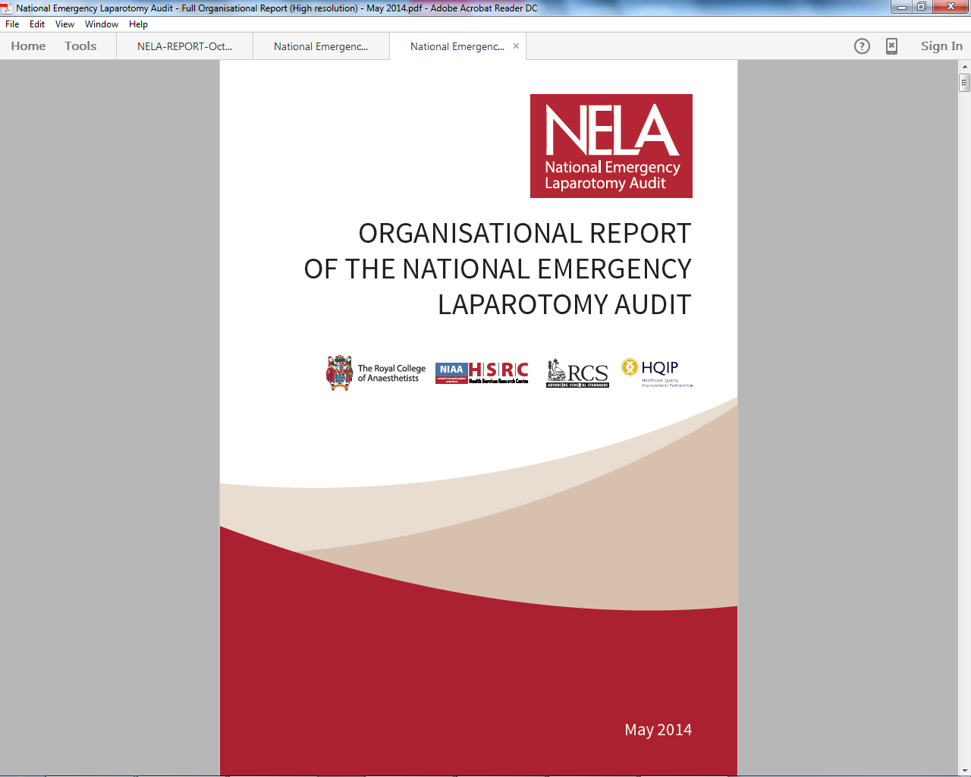
NATIONAL EMERGENCY LAPAROTOMY AUDIT PUBLICATIONS:
Organisational Audit
Patient Audit
Notes:
So far we have published an Organisational report in May 2014 and the First Patient Report in June 2015.
We are due to publish the Second Patient Report in June 2016.

Slide 8
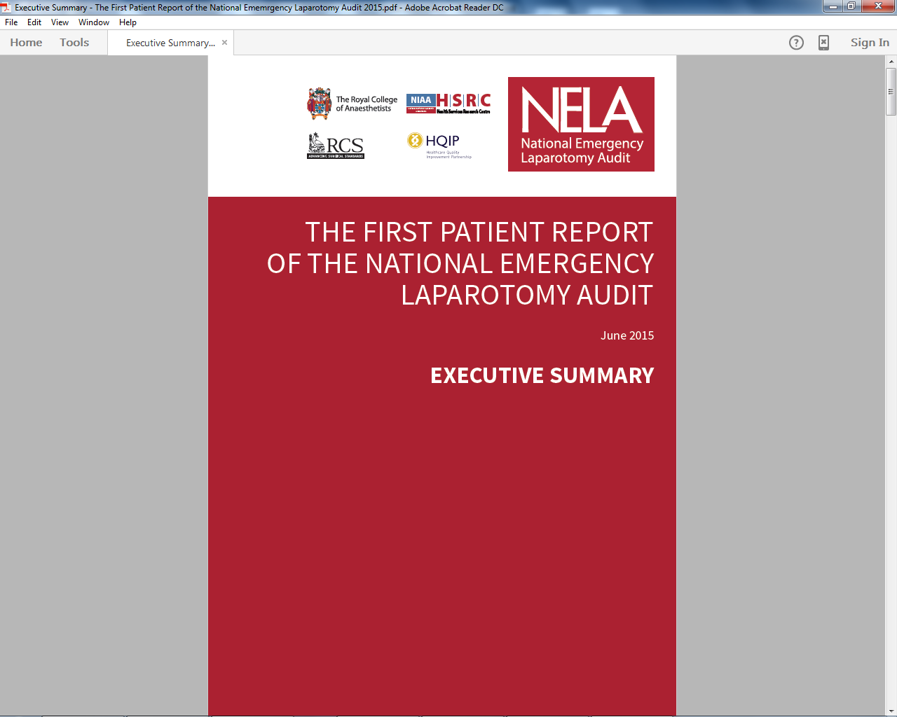
NATIONAL EMERGENCY LAPAROTOMY AUDIT PATIENT AUDIT REPORT:
Exec summary:
Key Themes
Recommendations
Findings
Notes:
The project team publish a short Executive Summary which includes all the Key Themes, Recommendations and Findings as a shorted version of the full report.

Slide 9
NATIONAL EMERGENCY LAPAROTOMY AUDIT PATIENT AUDIT REPORT:
Full Report:
How to read report
Standards
Measures
Findings
Audit Questions
Recommendations
RAG Table
Patient Story
Notes:
For the full report the Project Team decided to write one report that was both aimed at Clinicians, Managers and the Public. The language used intentionally tried to be understood by all. So that the pubic could get something out of it without talking down to the medical profession.
The full report was predominantly meant to be read as an online document. Allowing for specific phrases to be searched, for tables to be zoomed in on .

Slide 10
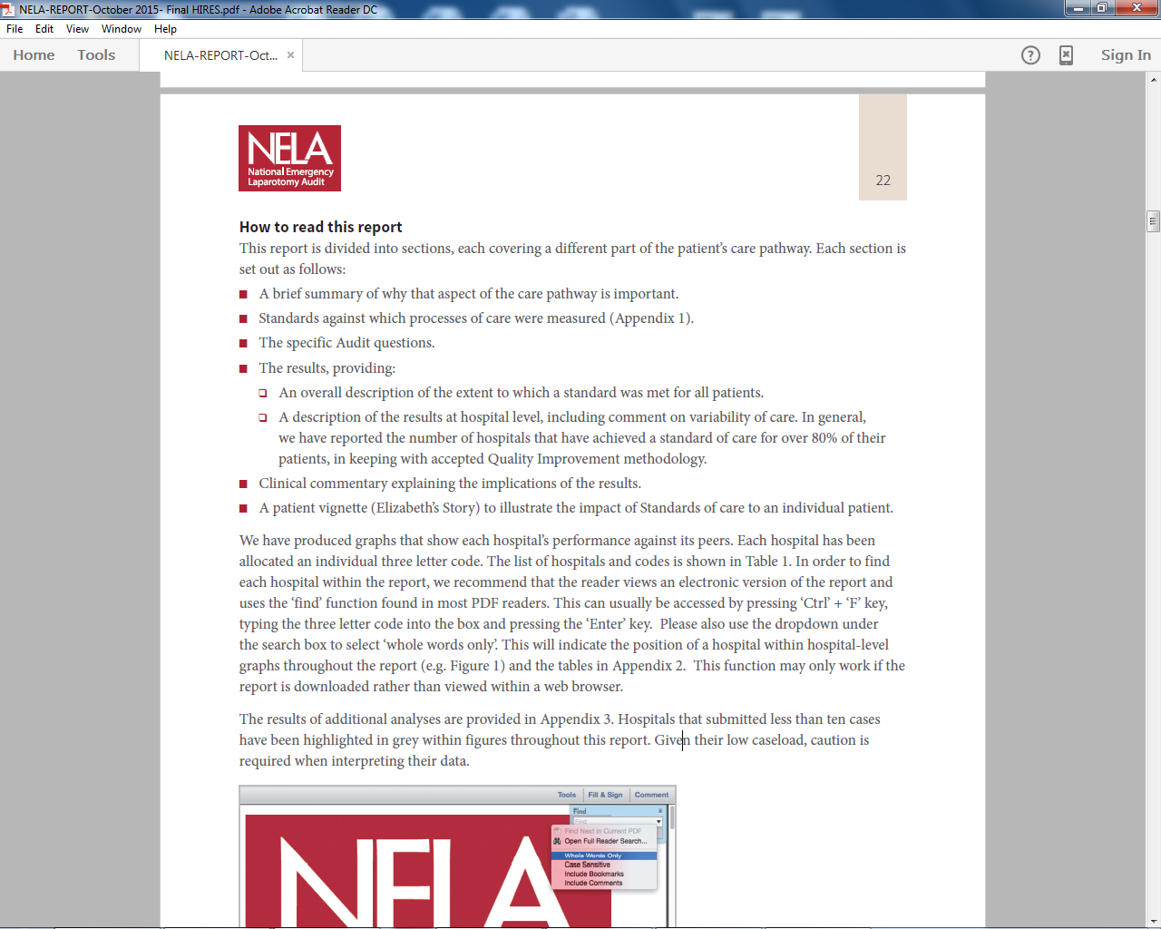
NATIONAL EMERGENCY LAPAROTOMY AUDIT PATIENT AUDIT REPORT:
Full Report:
How to read report
Notes:
We included a section on how to read the report – providing guidance on what each section of the report meant and how best to read it specifically online.

Slide 11
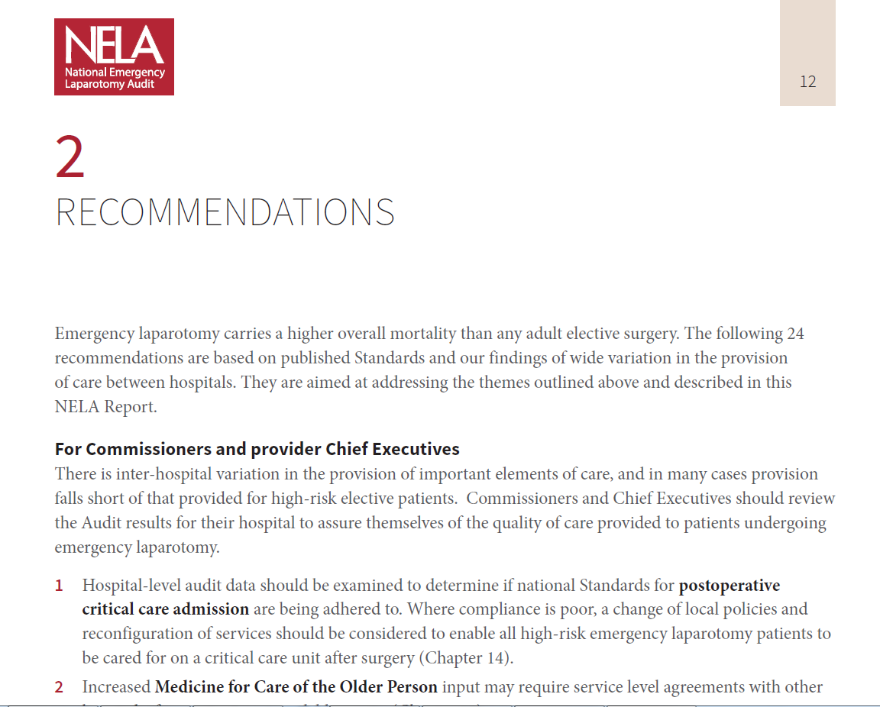
NATIONAL EMERGENCY LAPAROTOMY AUDIT PATIENT AUDIT REPORT:
Full Report:
Overall Recommendations
Commissioners
Chief Executives
Medical and Clinical Directors
Multidisciplinary teams
NELA Leads
Notes:
Both the Exec summary and the start of the Full Patient report included a section of all the recommendations made by the NELA project team.
These recommendations were divided up by who they were aimed at. There were specific recommendations that should be followed by Commissioners, CEO’s, Medical and Clinical Directors, Individual clinicians be they Surgeons, Anaesthetists, Nursing staff etc. And some recommendations for those NELA leads participating in the audit on how they can push local quality improvement.

Slide 12
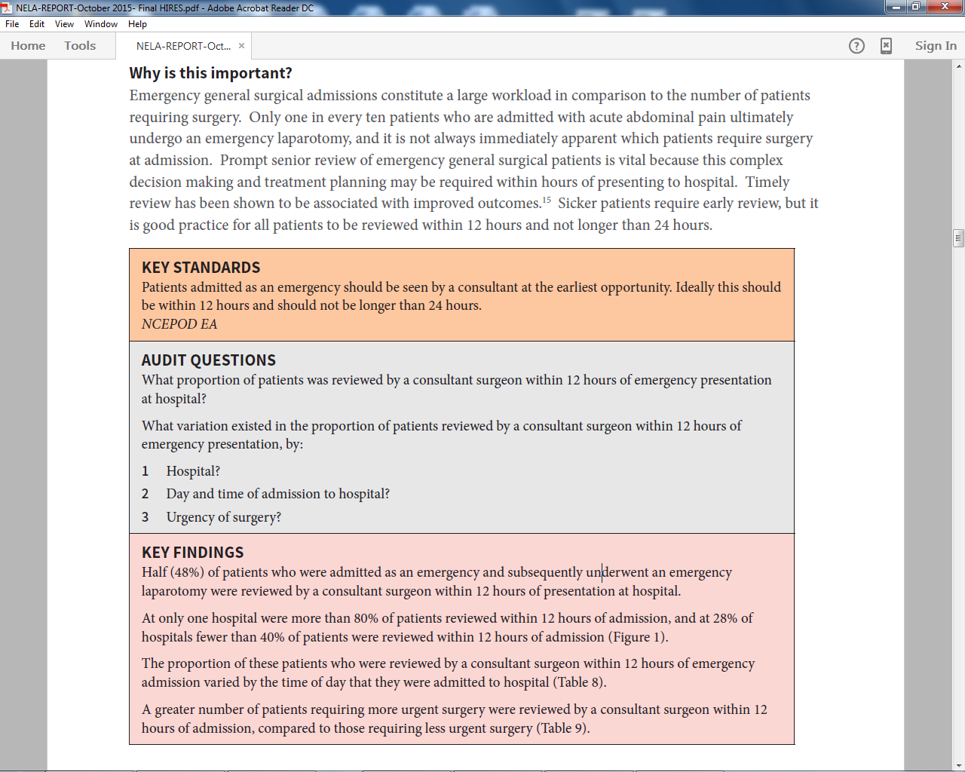
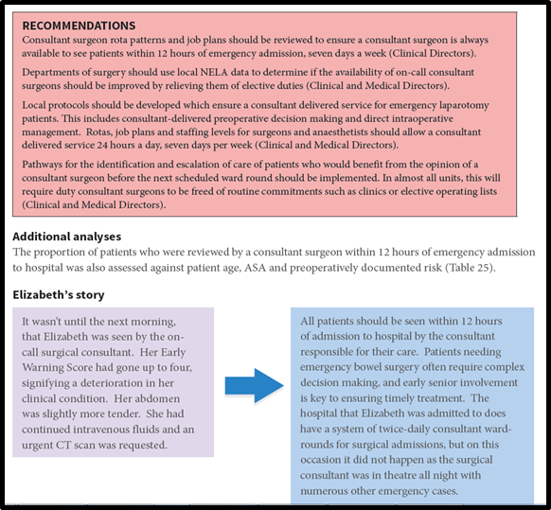
NATIONAL EMERGENCY LAPAROTOMY AUDIT PATIENT AUDIT REPORT:
Full Report:
Standards
Findings
Audit Questions
Specific Recommendations
Best Practice
Notes:
The report was divided into chapters covering specific measures.
Within these chapters each measure spelled out the Key Standards that hospital sites were being measured against. The actual questions asked in the audit, the key findings and then the recommendations from the NELA project team.
The report highlights how all these elements are linked and how change can improve quality of care locally.
The chapters also highlight examples of best practice - we contacted good performing sites and asked them what they did to get such results, this allowed us to share these with all participants both in the report and on the website.

Slide 13
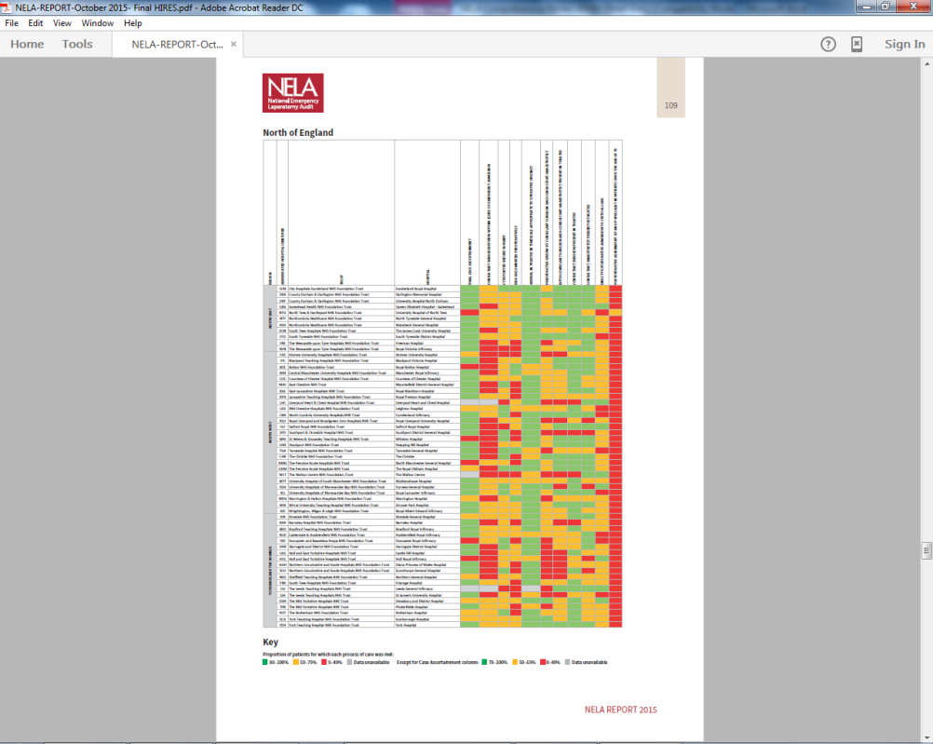
NATIONAL EMERGENCY LAPAROTOMY AUDIT PATIENT AUDIT REPORT:
Full Report:
RAG Table
Individual Hospital Results
Notes:
In the report the NELA team also included a RAG table of key measures. This allows for a quick look for participating sites to see where they stand. In future reports it will also allow for comparison to measure whether there has been improvement from one year to the next.

Slide 14
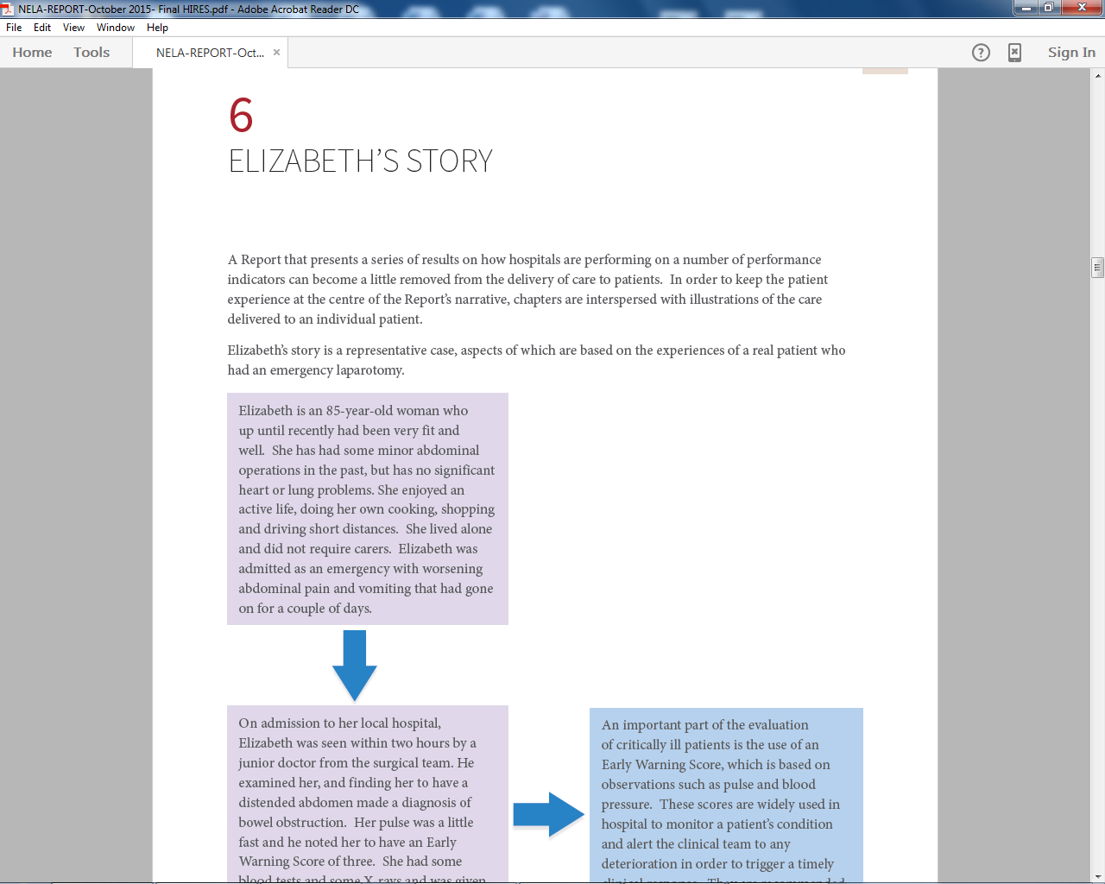
NATIONAL EMERGENCY LAPAROTOMY AUDIT PATIENT AUDIT REPORT:
Full Report:
Patient Story
Notes:
The project team decided to include an extra feature in the report last year – that was a patient story. This story was a representative case which was based on the experience of a real patient who had an emergency laparotomy.
These short vignettes were placed at appropriate places within several chapters to keep the patient experience at the centre of the report. This helped to bring to life the recommendations and how they truly impact on the patient.

Slide 15
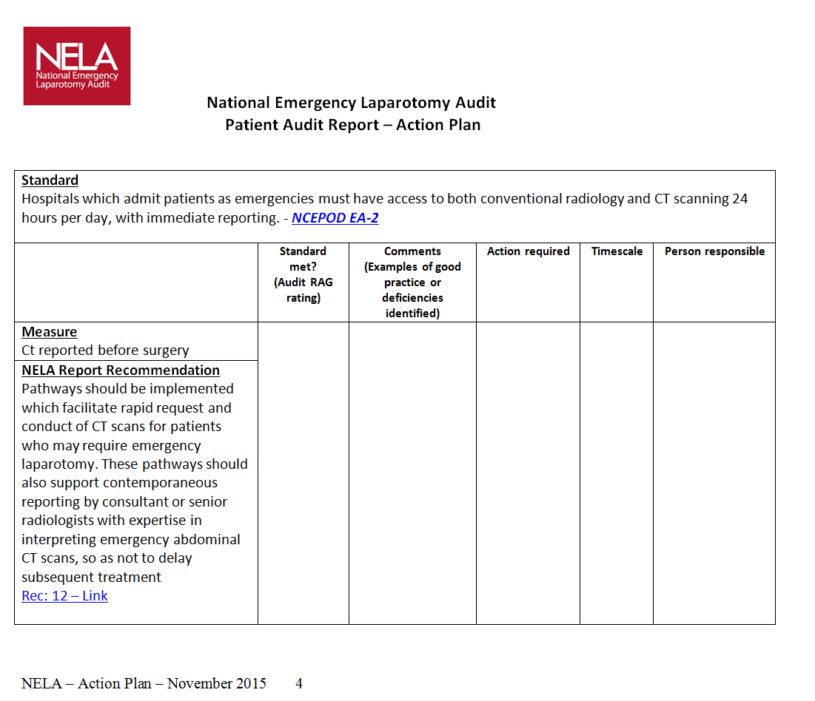
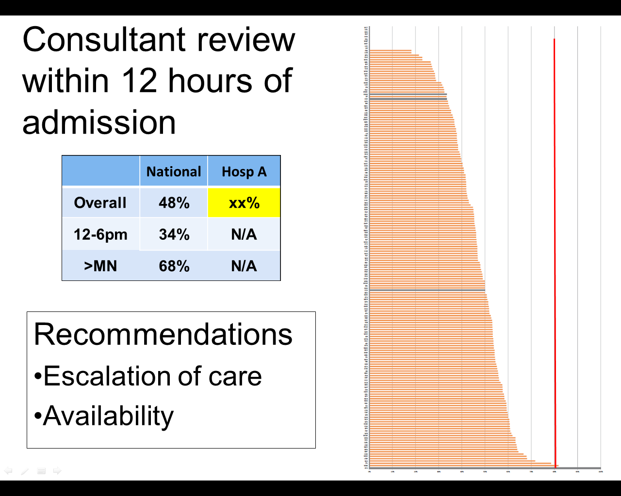
NATIONAL EMERGENCY LAPAROTOMY AUDIT PATIENT AUDIT REPORT:
Post Report and Ongoing Support
Hospital Action Plans
Template PowerPoint presentation
Dashboard
Notes:
We backed up the messages within the report with further documents that are aimed at assisting participants locally to measure their performance and carry out local quality improvement.
Hospital action plans - These forms provide an action plan to assist hospital sites in ensuring they are meeting the recommendations laid out in the NELA Patient Report and Organisational Report and if not what actions need to be taken to achieve these aims.
Presentation – provides a template that can be used for local presentations. Set of slides and notes for NELA Local Leads to present to their colleagues on the findings of the Patient Audit and Organisational Audit. Individual hospital outcome data for the Patient Audit slide-set can be found under the Hospital Documents page on the NELA online web tool.
We have been explicit in the report that this is about continuous local QI that uses local data to capture local performance, and not “audit” in the traditional sense of waiting for an annual report (and then ignoring it)!
The report alongside all the other elements we are making available to participants is about ongoing local improvement.

Slide 16
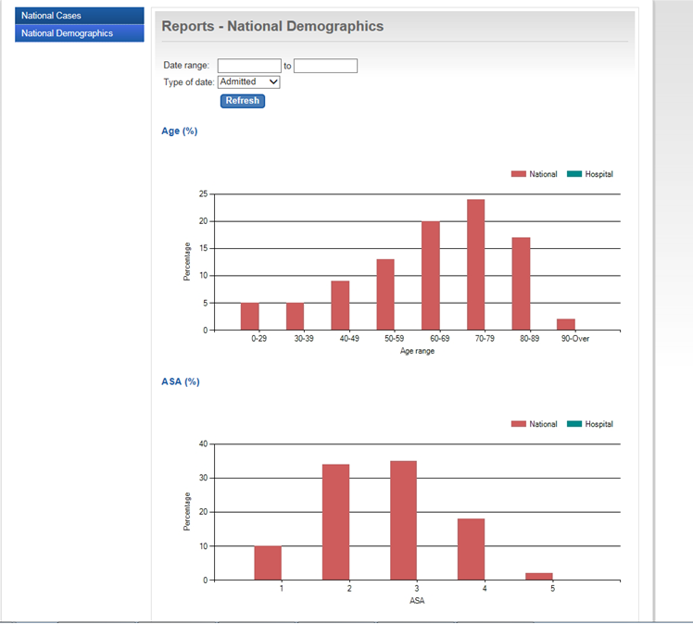
NATIONAL EMERGENCY LAPAROTOMY AUDIT
NELA DASHBOARD:
New Quality Improvement initiative being developed
Provides real-time feedback of local data in comparison to National
Allows for data to be easily viewed and interpreted
Demographics & Case Ascertainment
key QI indicators
Export own data
Notes:
This ‘Dashboard’ is providing real-time local data in comparison to National data in easy to understand graphs.
- It assists with entering data showing which cases need completing
And We continue to continue to develop this to include key indicators:
Presence of consultants
Timeliness of operation
Post op information etc

Slide 17
ANY QUESTIONS?
More information at: NELA.ORG.UK
Follow us on: @NELANews
Email: jlourtie@rcoa.ac.uk
Notes:
Thanks very much…. Any questions

